Slide 1
Friends of Salmon Bay – Community Survey
Retreat Report and Analysis
December 2015 – January 2016

Slide 2
Goals for FOSB Survey
To understand where the interests are of the full community.
To increase the engagement and involvement of the community, particularly new parents.
To receive feedback so FOSB can be more efficient and effective in our planning.
To best support the staff, as needed.

Slide 3
Summary
Community is engaged: over 270 replies with much gratitude for being asked. (Representative sample)
People are generally satisfied; more people are satisfied than not.
Vast range of priorities and interests.
6th Grade parents are the most likely to supply responses and want different types of support.
A good deal of people are generally not able or interested in changing their level of FOSB involvement right now.

Slide 4
Demographics
90% of respondents were parents.
10% were educators.
2% were alumni, extended family members, and one student.
(Some parents are also Salmon Bay educators.)

Slide 5
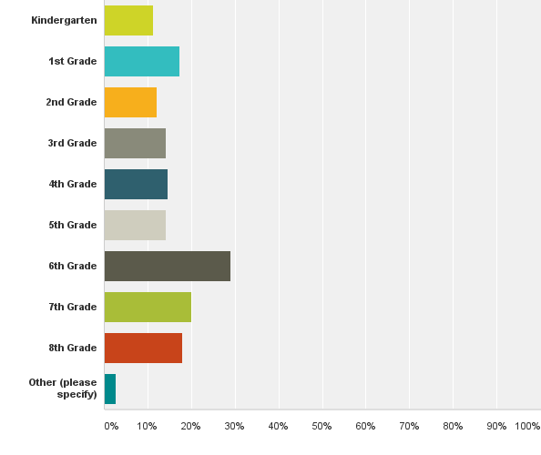
Demographics

Slide 6
FOSB Involvement Levels
FOSB EVENTS
Attended 5 +events 22%
Attended 3-4 events 24%
Attended 1-2 events 30%
No FOSB events 17%
Other/Comment 6%
Other: Many responses were to clarify how their involvement has evolved over time.
FOSB MEETINGS
Attend all FOSB meetings 5%
Attended 6-8 meetings 5%
Attended 3-5 meetings 6%
Attend one or two a year 28%
Never attended meeting 44%
Other/Comment 11%
Other: Most referenced prior involvement in years past.
Notes:
Inverse relationship. We’re getting them in the building after hours. AND 72% of the peeps filling this out barely or never have attended a FOSB mtg.

Slide 7
Barriers to FOSB Involvement
I am just too busy with my other priorities. | 56%
Meetings are held at a time that is inconvenient to me. | 38%
I am satisfied with the school and trust the staff to carry out the mission. | 33%
Other | 22%
The vibe wasn't as welcoming as I expected. | 14%
My partner or friends attend and notifies me of important information. | 12%
I never knew FOSB needed greater participation. | 12%
The agenda items just do not interest me. | 11%
Lack of clarity on what impact FOSB has on my child’s education. | 10%
Child care is not consistently available. | 8%
Lack of communication about agenda of meetings. | 4%
Lack of communication about location & time of meetings. | 3%
My teacher keeps me apprised of what is happening at school. | 3%
Comments: Issues with previous process paralysis, old interpersonal differences, difficulty returning to school after hours, wanting to get more involved down the road.

Slide 8
Factors to Increase Involvement
If the staff were presenting material that was pertinent or of interest to me. | 92%
If I saw a way to utilize and share my skill set. | 87%
If I was clear what the impact of involvement would be. | 82%
If my time commitment and/or role could be clear and established by me. | 79%
There is likely nothing that would increase my participation. | 77%
If someone in the parent community directly invited me. | 73%
If my teacher recommended that I should get more involved. | 69%
If there was a more social aspect to FOSB. | 62%

Slide 9
Where would like FOSB to focus?
Ranking | Item | Score
1 | Supporting Teachers and Staff | 87%
2 | Community Building | 84%
3 | Fundraising Activities | 79%
4 | Student Programming | 78%
5 | Parent Training on Curriculum | 70%
6 | Student Safety | 68%
7 | District & State-level Advocacy | 68%
8 | Parent Education | 64%
9 | Teacher Retention | 63%
10 | Celebrating and Enhancing Diversity | 57%
11 | Identifying & Supporting a Sister School | 44%
Notes:
Discussion on the difference of focus of FOSB and what peeps want to learn.

Slide 10
What do you want to learn through FOSB?
Notes:
Why are these answers different?

Slide 11
What is working?
Strong, Committed Teachers
Solid, Welcoming Community
Friday Sing, WEP, Frequent PE
Volunteer Coordinators
Parent Involvement
New Administration
Communication is good/improving.
Social-emotional Focus

Slide 12
22% of parents say there is nothing they’d change about their experience at Salmon Bay (Short Answer)
Exclusion of parents who work or do not have flexible schedules.
Not enough parent socialization
Inadequate digital communique
Need for more volunteers
ISSUES - FOSB

Slide 13
Ideas – FOSB – Part 1
Parent Sports Team or League *
Summer Book Club or Reading, especially for Middle Schoolers
FOSB logo on all sponsored events
More after-school events or programs, especially for Middle Schoolers *
More 6th Grade parent support, orientation, & socialization (MS Parent-only groups)*
Blogs, bulletin boards, online platforms for people who cannot attend meetings.**

Slide 14
Ideas – FOSB – Part 2
Name tags at every meeting
FOSB Liaisons for each grade or replicate Reading Buddies for FOSB
FOSB Orientation* (How to Get Involved night)
Promote FOSB’s site (there’s A LOT on there…)
Monthly podcasts on various topics

Slide 15
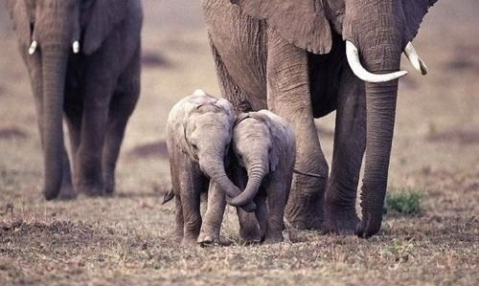
Suggested Framework
Should we do something about it?
Why will we do something about it?
What will we do about it?
Let’s make a plan then!

Slide 16
Next Steps
TOPIC 1: FOSB Involvement
TOPIC 2: FOSB Focus
TOPIC 3: FOSB Meeting Topics
Each group will:
Process the information on their topic. Record 2-3 observations, concerns, additional questions, etc…
Decide if there’s something to within your topic and why.
Suggest several strategies

Slide 17
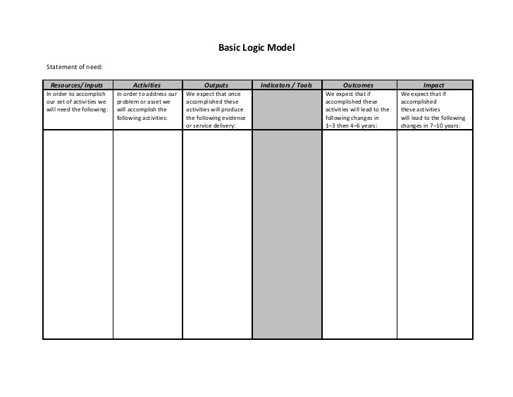
Implementation
Remember to indicate where new funds or significant increase in funds would be needed to accomplish this task.

